Slide 1
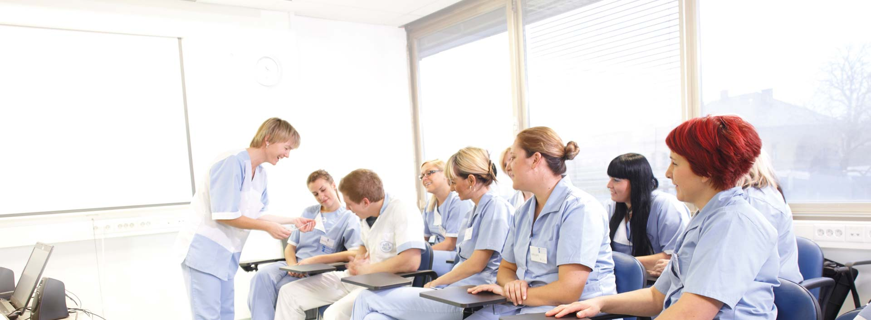
COLLEGE OF NURSING IN CELJE
Student: Kemal Ejub
Vist us: http://www.vzsce.si/en

Slide 2
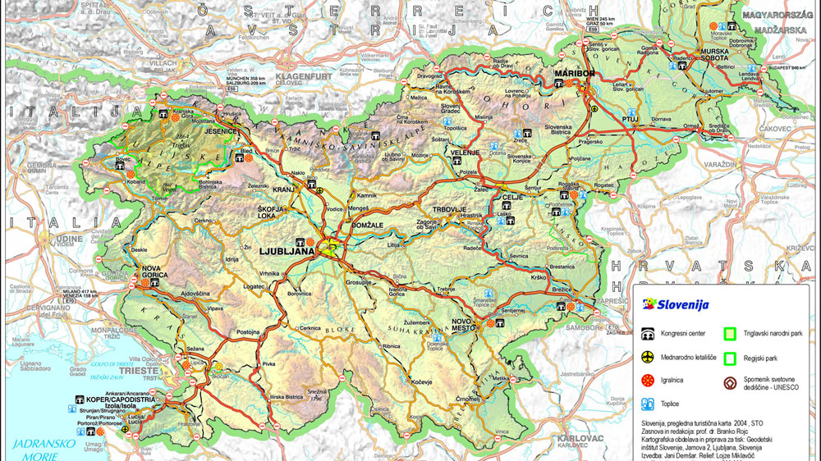
WE ARE HERE

Slide 3
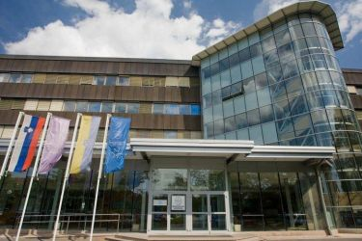
STUDY PROGRAMS IN SLOVENIA
1st bologna cycle (180 – 240 ECTS)
Higher education professional (RN) - 180 ECTS.
and university education program (Bachelor program) NOT IN NURSING.
Nursing (RN) – 180 ECTS (3-year)
2nd Bologna cycle (60 – 120 ECTS)
Master program
Master in Nursing – 120 ECTS (2-years)
Masters program in special areas.
3rd Bologna cycle (3-year)
PhD – Doctoral program

Slide 4
FIRST CYCLE
NURSING CARE STUDY PROGRAM
SECOND CYCLE
MASTER PROGRAMME IN PALIATIVE CARE

Slide 5
INTERNATIONAL COOPERATION
Erasmus+ Bilateral Agreements with 15 higher educational institutions
Multicultural Care in European Intensice Care Units
Healthy lifestyle for aging well
International project with: Poland, Finland, Portugal
European Conference of nursing students
2017 Magdeburg – Germany
2016 Slovenia – Celje
2015 Poland – Lublin

Slide 6
PROJECTS
Applied research project at the General Hospital Celje
International research project CompRU (Finland)
International research project Mentors competences

Slide 7
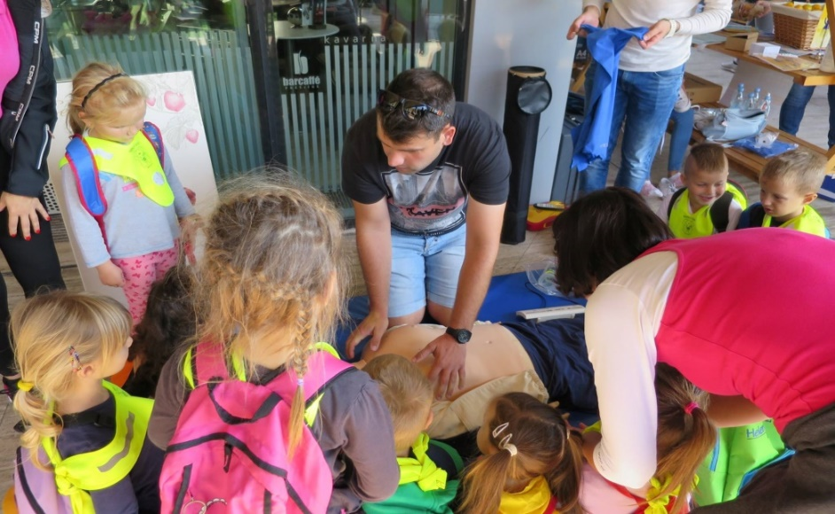
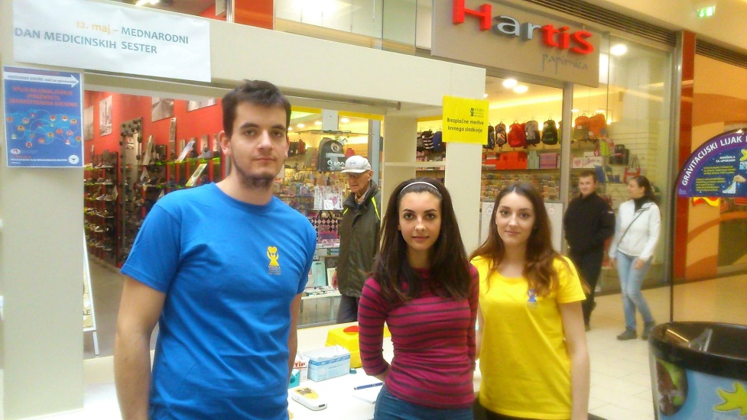
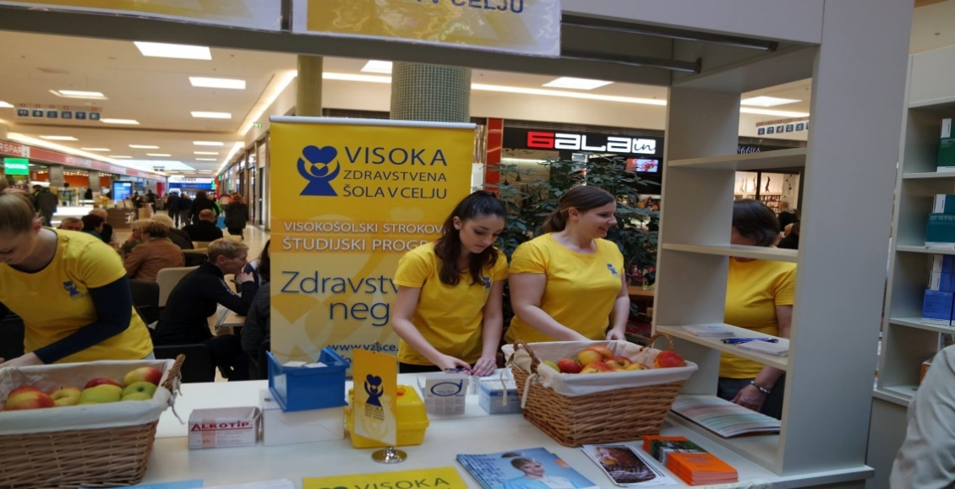
PARTICIPATION IN ACTIVIES OF THE CNC IN ENVIROMENT
Empowerment of the population with knowledge about health,
health promotion,
Increasing health literacy among people
Promotion of healthy lifestyle.
Counseling
Promotion of the CNC

Slide 8
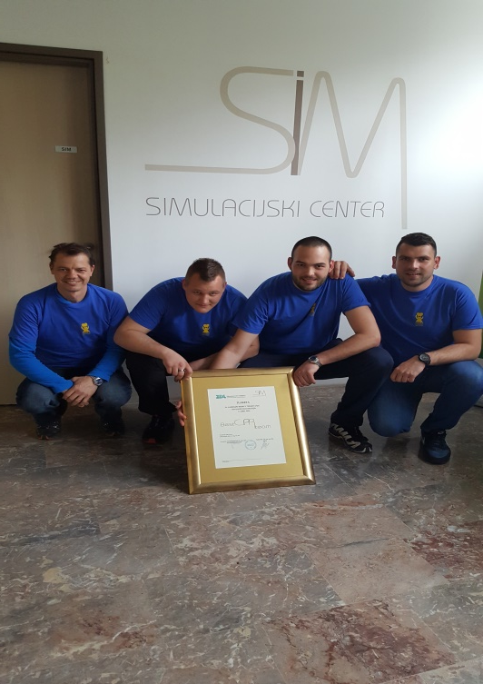
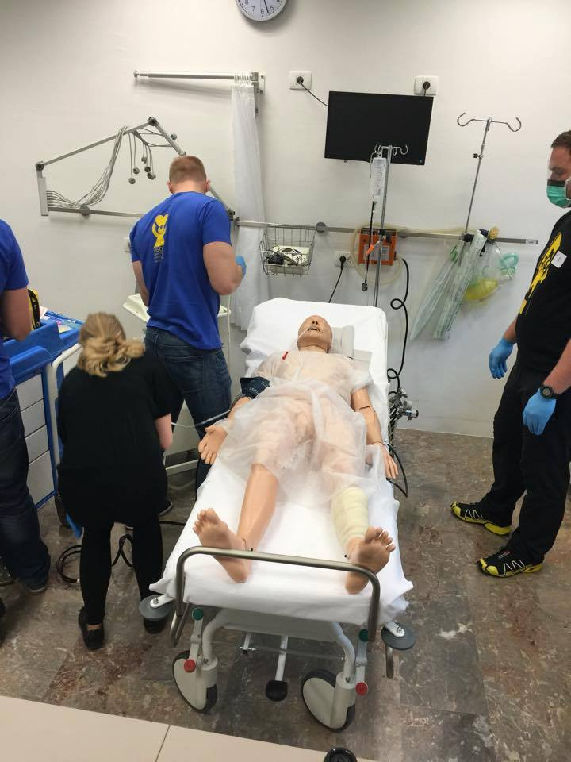
COMPETITIONS, COOPERATION, WINNING
Competition in basic llife support : First place in the category of professionals.

Slide 9
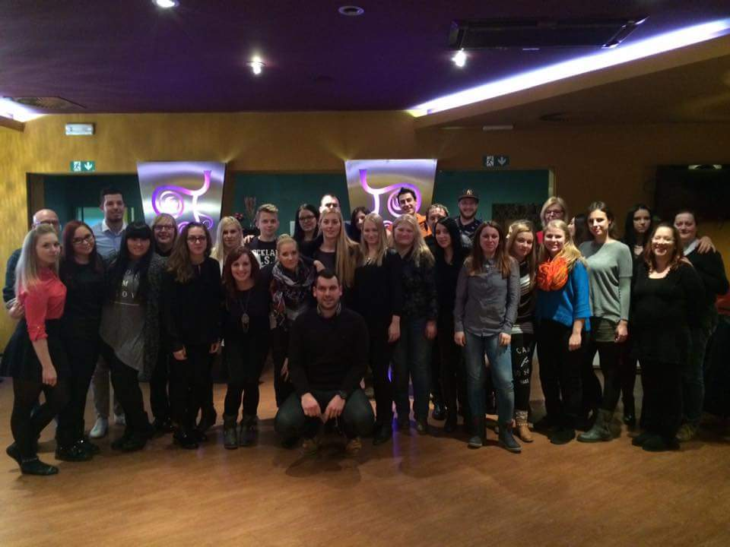
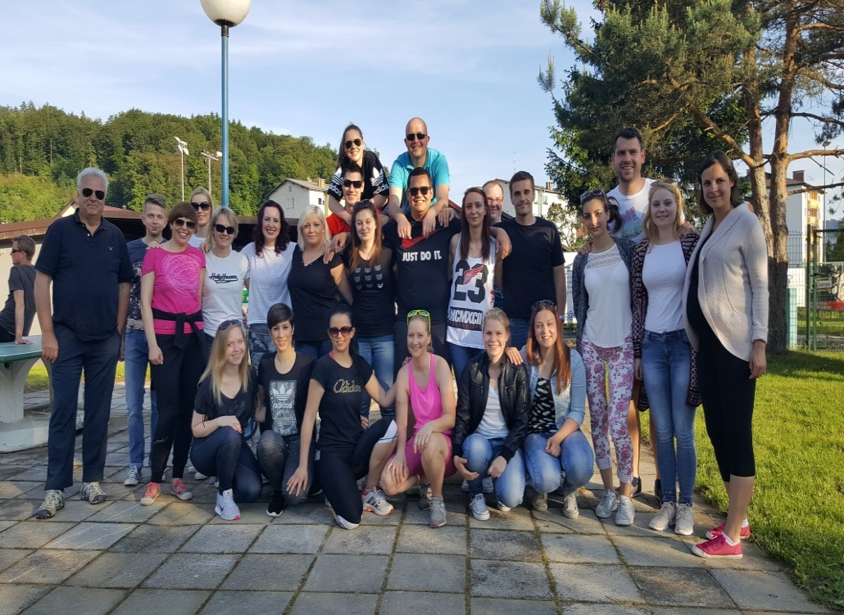
SOCIALIZING ☺
Picnics
Farewell party for students
Team cooperation

Slide 10
KEY POLICY AND PRACTICE RELATING TO ADOLESCENT HEALTH AND WELL- BEING
Children and adolescents have the right to compulsory health insurance as family members of aninsured person until the end of their regular education
Physicians working with children and adolescents in primarylevel have a 5-year specialization in pediatrics.
Slovenia is facing a workforce crisis,as the number of health professionals retiring is not adequately being replaced by new trainees. There is also a netdeficit of nurses with university and college degrees.

Slide 11
KEY POLICY AND PRACTICE RELATING TO ADOLESCENT HEALTH AND WELL- BEING
Slovenia has already adopted a number of health care policy
Adoption of strategic and action plans in:
NUTRITION AND PHYSICAL ACTIVITY,
DIABETES PREVENTION AND CARE PGORGAM,
A TOBACCO CONTROL PROGRAM.
Institute of Public Health is responsible for health promotion and education programs
Primray health care level

Slide 12
KEY POLICY AND PRACTICE RELATING TO ADOLESCENT HEALTH AND WELL- BEING
1. Health education for childrens and adolescents – Community Health care
Is provide at preventive examinations at primary level
Registered nurse for every group of childrens we provide 2 hours per year for health education.
99% of Slovenian primray Schools are involved in program of health promotion.
What we promote?
Healthy lifestyle
Healthy eating
Sex eduaction

Slide 13
Receiver of six national and international awards
Example of good practice – WHO publications
Supported by Ministry of Health
This is Me prevention programme
Universal prevention programe for adolescents (13-17y)
School prevention
(evidence based model of 10 prevention workshops) promotion and reinforcement of SEL skills & competencies, realistic self-esteem
Web counselling service
providing adolescents with a free, anonymous and public access to expert advice
18 years
BUILDING PERSONAL RESILIENCE
National Institute of Public Health (since 2001)

Slide 14
KEY POLICY AND PRACTICE RELATING TO ADOLESCENT HEALTH AND WELL- BEING
3. Mental Health care of children and adolescents
Slovenia provide preventive, curative and rehabilitation care.
Primary, secondary, and teritary health care.
Geographically distributed throughout the country.
Multidisplinary aproach (nurses, social workers, speech and language therapists, special educators, occupational therapists, physiotheraptist, clinical psychologist, pediatricians, and child and adolescents psychiatrists).

Slide 15
Mental Health Center for children and adolescents in 2019
10 Mental Health Centers for children and adolescents in Slovenia 10 Mental Helath Centers fo Adults

Slide 16
WHAT IS GOOD AND WHAT CAN WE CHANGE?
Only 25 child and adolescents psychiatrists working in Slovenia
They manage 46 hospitals beds in 3 separate hospital wards
We don‘t have highsecurity ward for children and adolescents in Slovenia with sever mental disordes.
Low range of psychologist
We have a team approacht to the treatment of mental and behavioral disorders
We have good preventive programs in health of childrens and adolescentes.
Juričič, M., Truden Dobrin, P., Paulin, S., 2016. Health care System for Children and Adolescens in Slovenia. The Journal of Pediatrics, 177, pp. S173-S186.
https://doi.org/10.1016/j.jpeds.2016.04.054

