Slide 1
Adolescent Mental health in the UK
India Wilkes and Caitlin Wick

Slide 2
What is defined as an adolescent?
‘A young person who is developing into an adult’
(Merriam-Webster Dictionary, 2019)
A UK government document defined adolescence as people aged 11-19 years
(Viner, 2012)

Slide 3
What is mental Health?
Our emotional, psychological, and social well-being, and it affects how we think, feel, and act
(BBC, 2016)
Mental health refers to the person’s cognitive and emotional wellbeing
(Royal College of Nursing, 2019)
A state of wellbeing in which the individual realises his or her abilities, can cope with the normal stresses of life, work productively and fruitfully, and is able to make a contribution to his or her community
(World Health Organisation, 2001)
Mental health includes our emotional, psychological, and social well-being. It affects how we think, feel, and act. It also helps determine how we handle stress, relate to others, and make choices.
(MentalHealth.gov, 2019)

Slide 4
Statistics
National
Lincolnshire
75% of mental health conditions are diagnosed by the age of 18 (Jeremy Gee, 2018)
Emotional disorders such as anxiety and depression are more common in girls (10%) than boys (6.2%) (NHS Digital, 2018)
20% of adolescents may experience a mental health problem in any given year (Mental Health Foundation, 2019)
5,325 11-16 year olds diagnosed with a mental health disorder in 2014 (Lincolnshire Research Observatory, 2016)
In 2018, 15% of girls in Lincolnshire reported low life satisfaction
In 2018, 6.7% of boys in Lincolnshire reported low life satisfaction
9.7% of boys in Lincolnshire have ever self-harmed
21.5% of girls in Lincolnshire have ever self-harmed

Slide 5
Demographics

Slide 6
Demographics

Slide 7
Policy and Law
Mental Capacity Act
The Mental Capacity Act 2005 was created to protect and empower individuals lacking capacity to make decisions about their care.
The MCA applies to people aged 16 and over.
(Mental Capacity Act, 2005)
In order to decide whether a child under 16 is able to consent to their own medical treatment, without the need for parental permission or knowledge they are assessed to establish if they are competent to make such decisions. This assessment is referred to as ‘Gillick Competence’.
(Young Minds, 2018)
If a young person under the age of 16 is not said to have ‘Gillick Competence’ they will need parental permission to be treated for their condition.

Slide 8
Policy and Law
Mental Health Act
The Mental Health Act 2007 applies to all children and young adults under 18. The Act contains some new provisions and specific safeguards for under 18s. Amongst other things:
16 and 17 year olds with capacity cannot have their consent or refusal to informal admission to hospital overridden by those with parental responsibility
At least one of the people involved in the assessment on admission and treatment under the Act should be a clinician specialising in Child and Adolescent Mental Health Services (CAMHS). Where this is not possible, a CAMHS clinician should be consulted as soon as possible
ECT cannot be given without approval of a second opinion appointed doctor (SOAD) even if the child/young person consents to it, unless it is an emergency
Children/young people detained under the Act must be referred after one year (as opposed to three for adults) for a tribunal hearing.
(British Medical Association, 2016)

Slide 9
Services
CAMHS
Talking Therapies
Inpatient Services
Charities
Other services

Slide 10
CAMHS
Child and Adolescent Mental Health Services. CAMHS are the NHS services that assess and treat young people with emotional, behavioural or mental health difficulties.
Work with the individual up to the age of 18, or 24 if they have been in care
5+ services in Lincolnshire and surrounding areas
GP, parents, teachers or the person themselves can refer to CAMHS
4 Tiers of Services
People who are not specialist mental health practitioners (GP, School Nurse, Teacher, Social worker etc)
CAMHS specialists in community and primary care settings
Multidisciplinary Teams working in a community mental health setting or outpatient service dealing with more severe and complex disorders
Intensive community treatment services for people who are at greater risk of suicide, self harm or are a risk to others

Slide 11
Talking Therapies
Cognitive Behavioural Therapy – talking therapy aimed at helping people manage their problems by altering how they think and behave. Individuals identify problems that impact their mental health and the therapist helps the individual change these unhelpful thoughts and behaviours.
Dialectal Behavioural Therapy – adapted from CBT and mainly used to treat Emotionally Unstable Personality Disorder (EUPD). It aims to help the individual accept who they are but make positive life changes to reduce and relieve stress.
Family therapy- family therapy is used to help those in close relationships understand and better support each other. Family members can express and explore difficult thoughts in a safe environment and enables working together to make useful changes in relationships.

Slide 12
Inpatient services
General adolescent unit – 12-18 year olds. Tier 4 units provide support for individuals with mental health conditions. People will be admitted to a GAU if they are expressing suicidal ideation and cannot maintain their safety in the community.
Low Secure – intensive therapeutic and rehabilitative programmes for adolescents in a low secure setting.
High Dependency Unit – for individuals whose level of risk and complexity cannot be managed in a general acute wards
Psychiatric Intensive Care Unit – 12-18 year olds who present with an acute deterioration in mental state who cannot be safely managed at a GAU or HDU

Slide 13
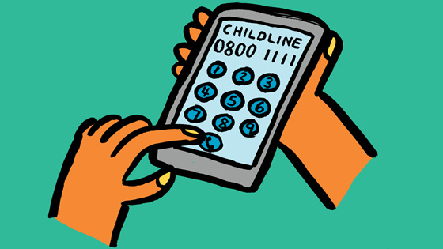
Charities and other services
Anxiety UK
User led organisation that provides online information and support for those struggling with anxiety. It aims to bring about specialised services and raising awareness about the disorder. It also has information for parents who want to know how to support their child
Headspace
An app withhemed sessions and podcasts to support and calm those dealing with stress, anxiety or sleep problems. It also has exercises to aid with breathing and mindfulness.
Childline
A free and confidential service for children where they can call or email to speak to a counsellor about any issue they may be facing.
Young Minds
Provides online information and support to young people struggling with mental health problems

Slide 14
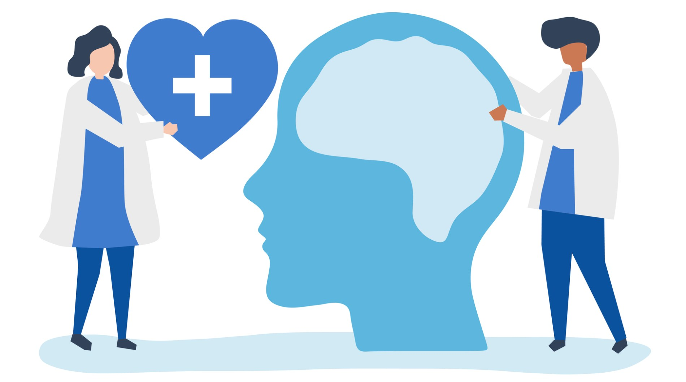
Nurse’s Role in treating mental Health in adolescents
Mental Health Nurses
All Nurses
Mental health nurses work in a variety of settings and support and treat people who have been diagnosed with a mental illness.
Promote mental health by building good relationships with patients, encouraging healthy behaviours, and recognising and treating symptoms early. (Royal College of Nursing , 2017)
All nurses have a responsibility to promote good mental health in order to prevent problems and to support patients who may have a mental illness (Royal College of Nursing , 2017)
The NMC code states that nurses should make sure that a person’s physical, social and psychological needs are assessed and responded to (Nursing Midwifery Council, 2018)

